Slide 1
Reinforcement Learning for Developing an Intelligent Warehouse Environment
Van Luan Tran, Manh-Kha Kieu, Xuan-Hung Nguyen, Vu-Anh-Tram Nguyen, Tran-Thuy-Duong Ninh, Duc-Canh Nguyen, Narayan C. Debnath, Ngoc-Bich Le, and Ngoc-Huan Le
Presenter: Van Luan Tran
luan.tran@eiu.edu.vn
Notes:
Our MBNet has two branches, one is for semantic segmentation of lumbar vertebrae, sacrum, and femoral heads. It shares the main features with the second branch to learn and classify by supervised learning.
The output of the second branch is to predict the inspected values for lumbar vertebra inspection.

Slide 2
Outline
Introduction
Related work
Solutions
Experimental results
Conclusions

Slide 3
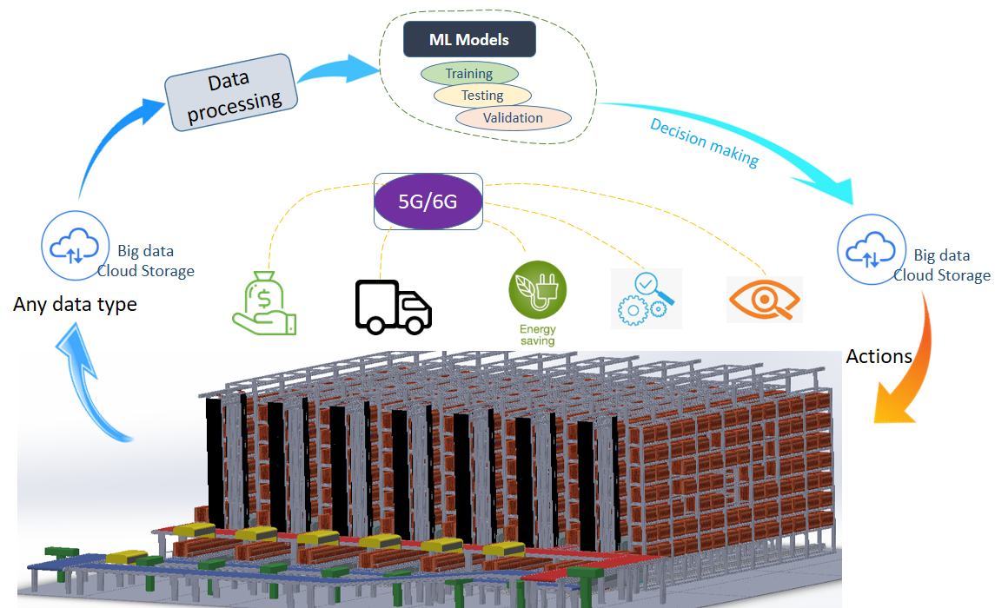
Introduction
Warehouses play a critical role in the supply chain of food and agricultural goods, especially in the Vietnamese market.
The warehouse is an essential component of Vietnamese logistics.

Slide 4
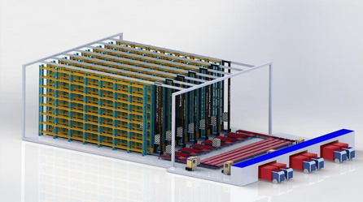
Introduction
Overview of the EIU smart warehouse with simulation.

Slide 5
Introduction
The EIU Smart Warehouse project:
• Hardware solution for smart warehouse.
- Storage racks: 7 units can store up to 1372 pallets,
- Automatic guided vehicle (AGV): 7 units,
- Circulation conveyor system,
- Sensor system (RFID) and technology solutions in smart warehouse manage-ment,
- Controller (PLC) and control algorithm.

Slide 6
Introduction
The EIU Smart Warehouse project:
• Software solutions for smart warehouse.
- Solutions to connect the physical controller system and management soft-ware,
- Solutions to optimize operating eﬃciency.

Slide 7
Introduction
Automatic guided vehicle (AGV): 1 units,

Slide 8
Introduction
The main point of our contribution.
Present with basic knowledge about four types of techniques: unsupervised learning, supervised learning, reinforcement learning, and imitation learning.
Propose the use of a reinforcement learning algorithm to perform an eﬃcient storage policy and an optimization technique in a warehouse environment.
Build a virtual warehouse environment and a robot with reinforcement learning for the optimization techniques.

Slide 9
Related work
Kamoshida et al. proposed an automated guided vehicle route planning policy in a warehouse environment using deep reinforcement learning [16]
Reinforcement learning is proposed to solve inventory management problems [23] and supply chain optimization [2].

Slide 10
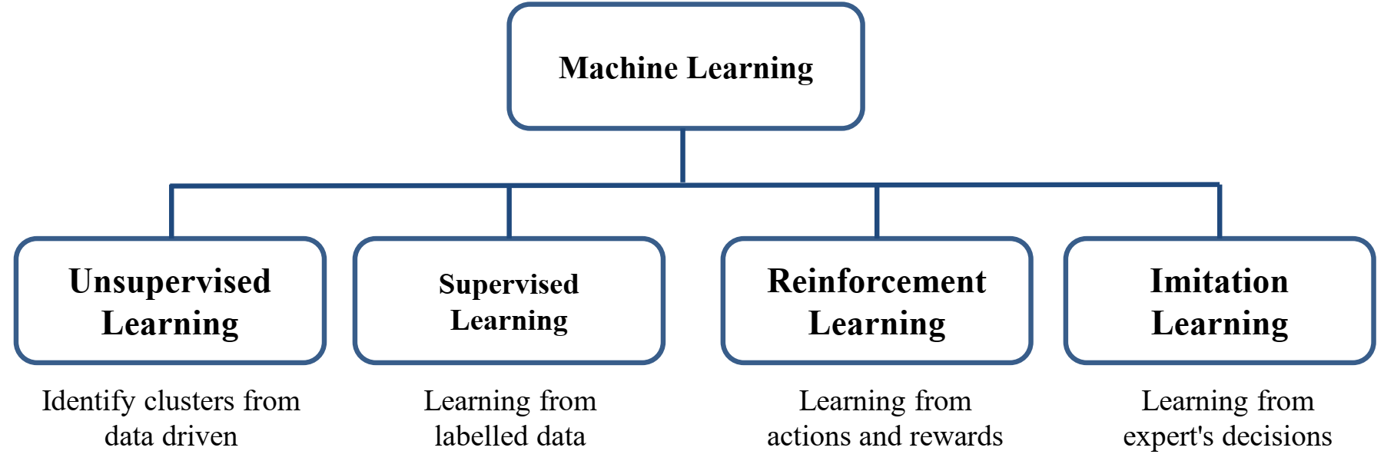
Solution
Machine Learning Techniques

Slide 11
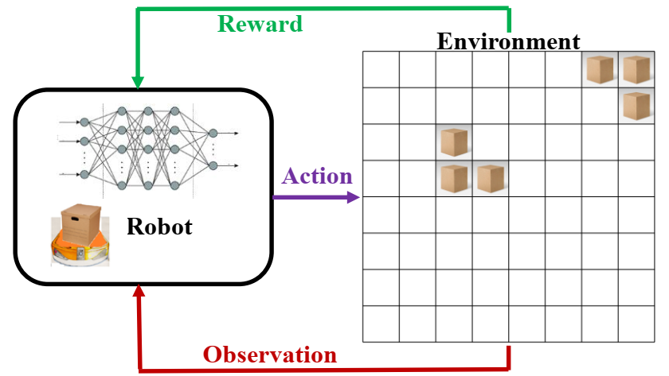
Solution
Overview of the basic of reinforcement learning where the robot is learning in a simple warehouse environment.

Slide 12
Solution
The basic of reinforcement learning:
Robot has the first observation information to initiate the first location in the warehouse coordinates.
Robot is trained with four moving strategies having actions as Up, Down, Left, and Right.
A neural network model is built with an input layer, hidden layer, and output layer.
The input layer has the shape of GridColumn∗GridRow, that is the number of the storing location in the basic warehouse.
The output layer is the number of actions.

Slide 13
Solution

Slide 14
Solution
The proposed method was trained with two policies.
The first policy is the robot moving randomly to find the target location. If the robot moves to the occupied location or the visited location, it will get punishments. Otherwise, if the robot moves in the target locations, it will get rewards.
The second policy is the robot moving randomly to find the target location, like the first policy. In addition, a reward policy is set up for each action. If the robot moves in the direction of the target, it will get a reward. Otherwise, it will get a punishment.

Slide 15
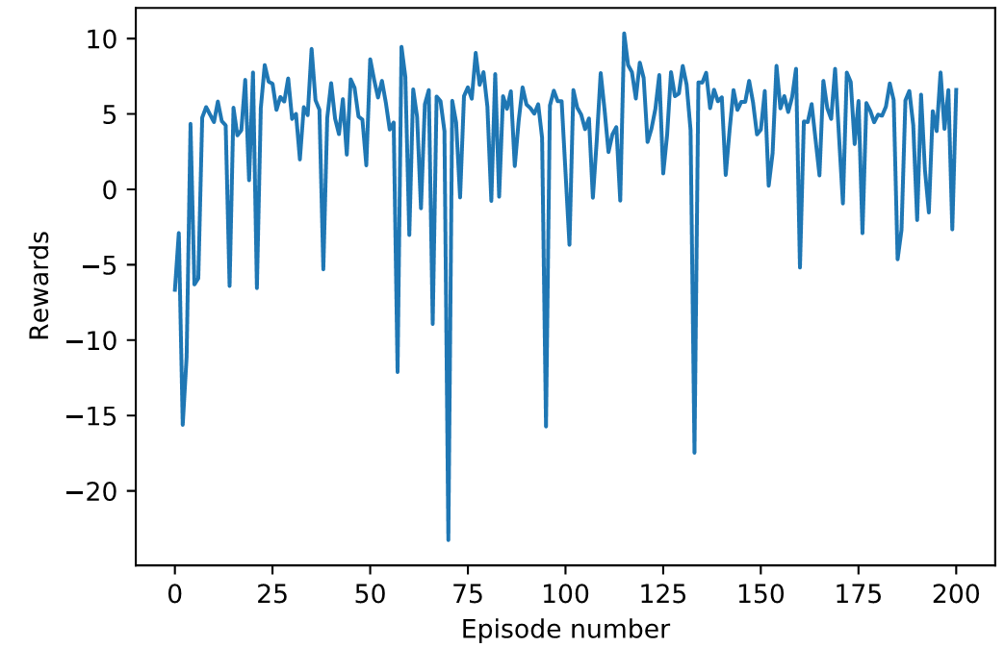
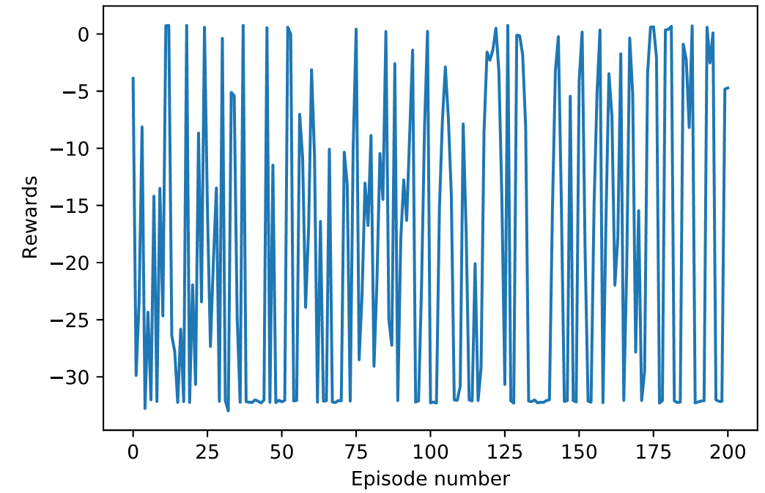
Experimental results
Rewards per episode of the training with 200 episodes:
a) the first policy
(b) the second policy

Slide 16
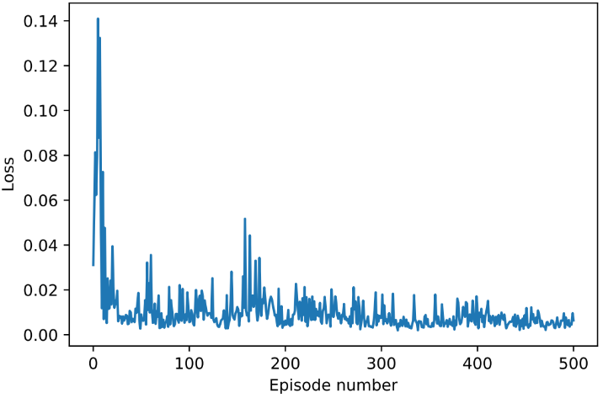
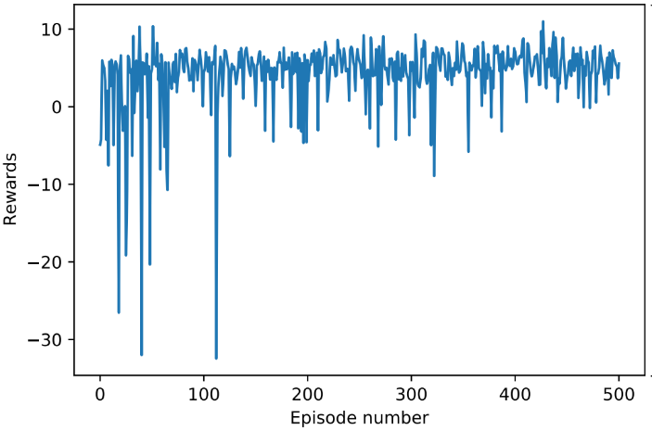
Experimental results
Training for the reinforcement learning was done with 500 episodes
a) Loss per episode
(b) Rewards per episode

Slide 17
Conclusions
Presented the machine learning technique to outline the algorithm for developing smart warehouse solutions.
Proposed and trained a reinforcement learning in a simple warehouse environment with specified policies.
A simulation environment was built to test the policies for rewards and penalties for the actions in training the reinforcement learning algorithm
Further study and develop a deep reinforcement learning algorithm for multi-agent complex

Slide 18
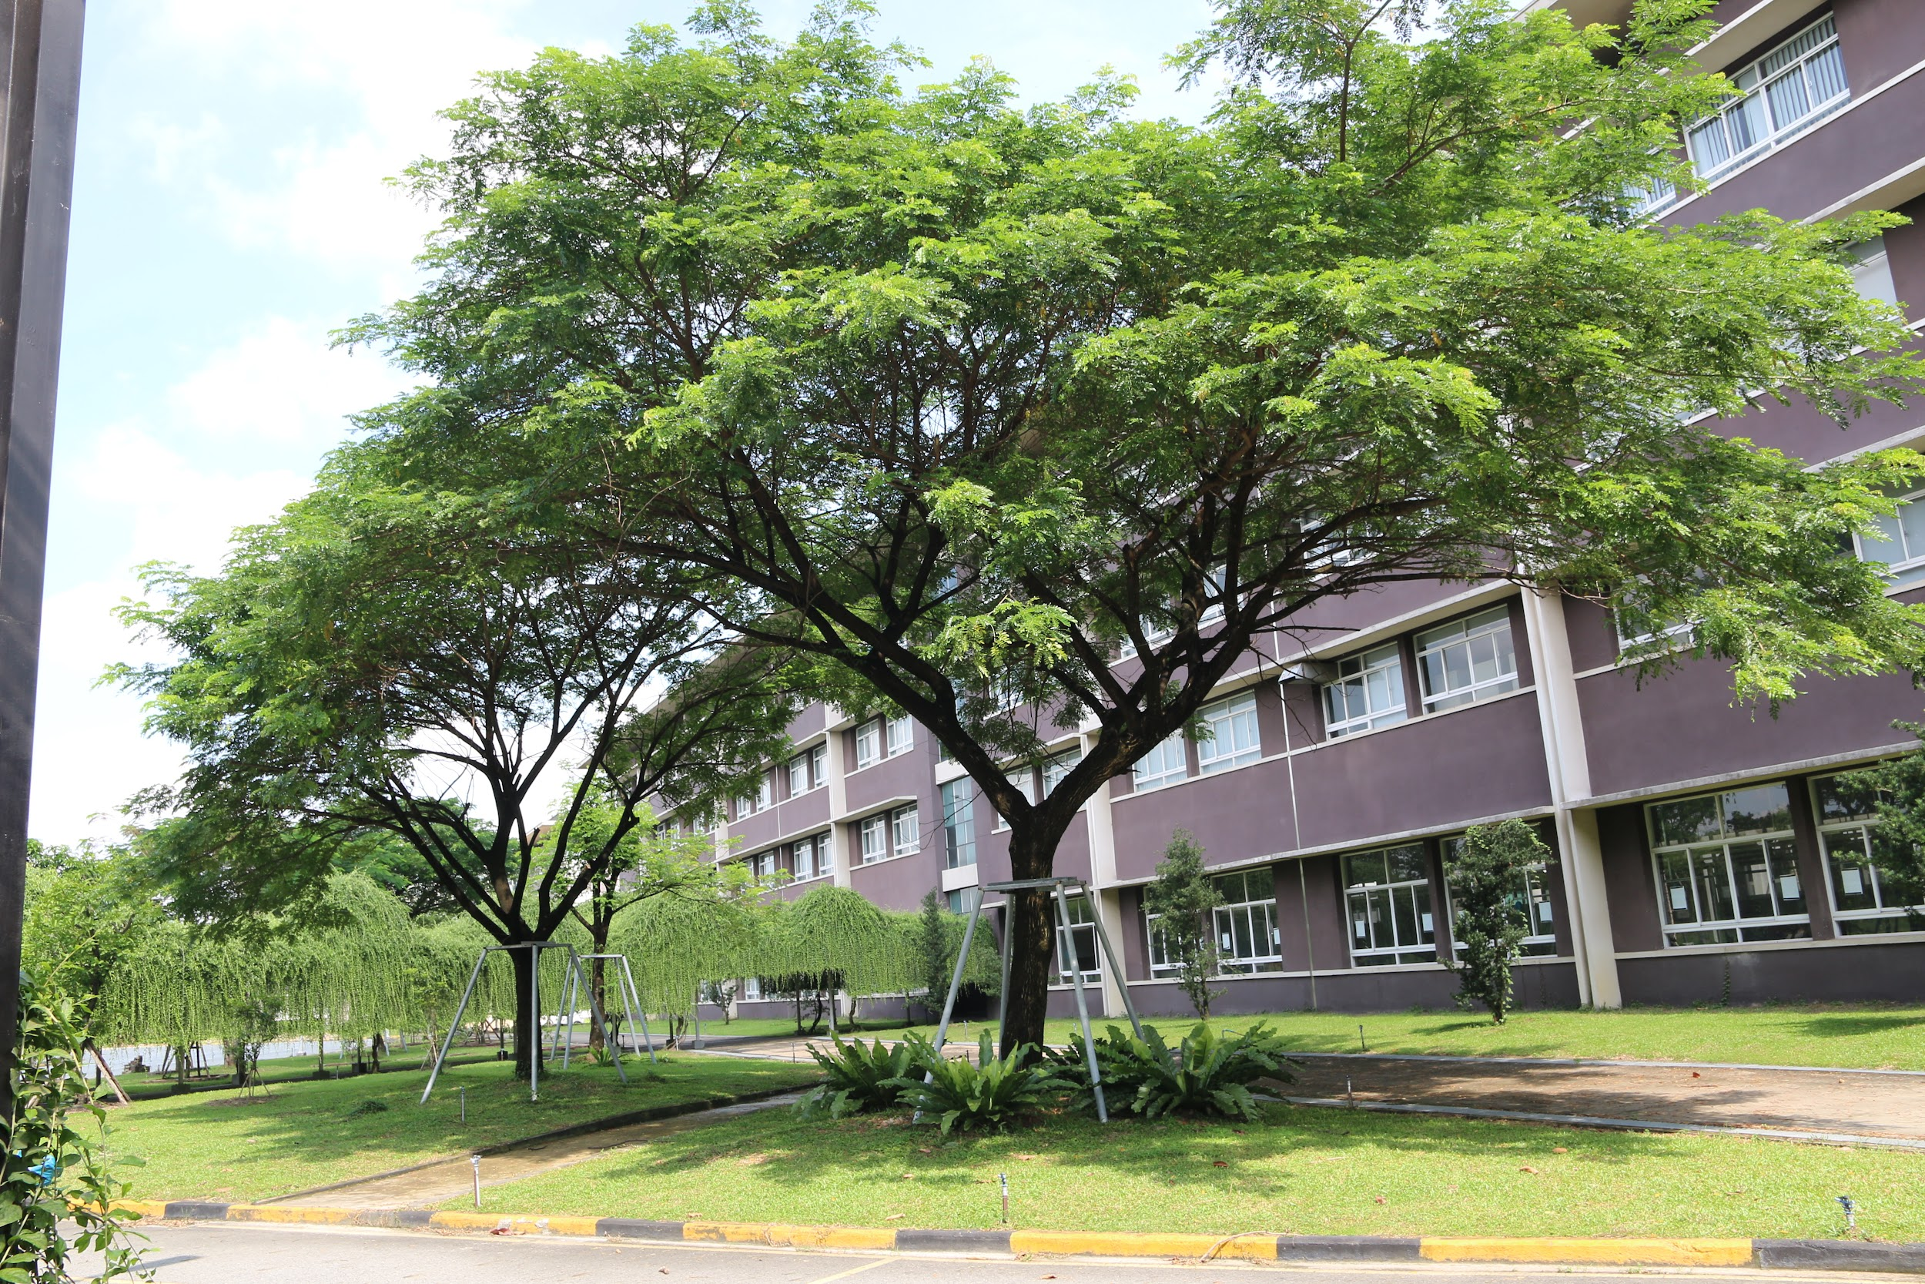
Thank you for watching.
Van Luan Tran, Manh-Kha Kieu, Xuan-Hung Nguyen, Vu-Anh-Tram Nguyen, Tran-Thuy-Duong Ninh, Duc-Canh Nguyen, Narayan C. Debnath, Ngoc-Bich Le, and Ngoc-Huan Le

